Slide 1


Enhancing
“Outpatient System”
In NeuroEspitalia hospital

Slide 2

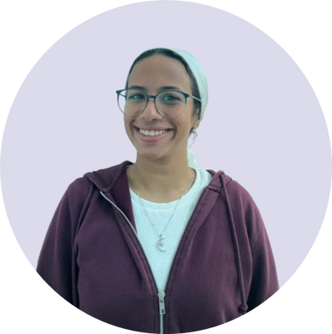
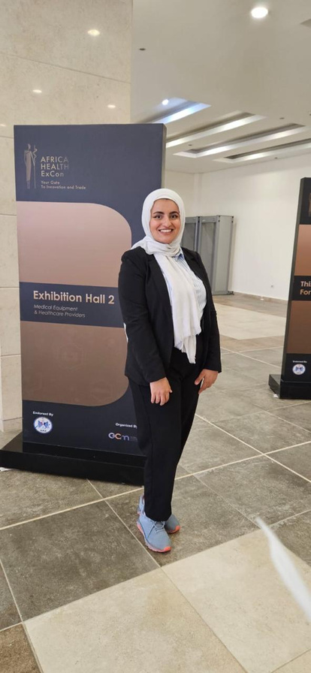

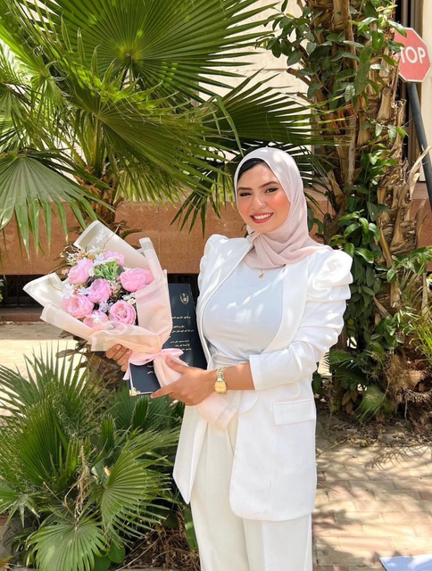
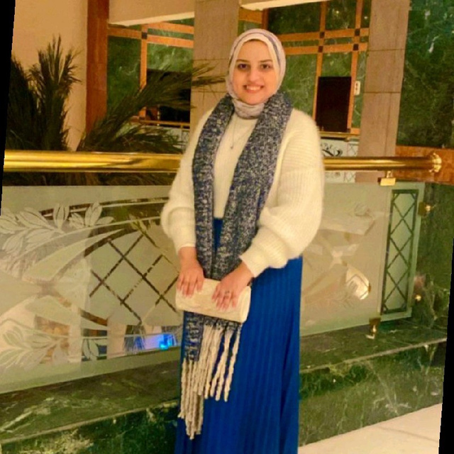
Team Members
Mayar Haitham
Noran Nagy
Silwan ElKhateb
Mariam Fouad
Yasmin Abdelsamiee

Slide 3


OUR AGENDA:
Situational Statement
Work Breakdown Structure
Root cause Analysis
Milestones
SWOT Analysis
Network Diagram
Smart Goals
Gantt Chart
Objective and Key Results
Budget Plan
Stakeholders Analysis
Risk Plan
Power Grid
Communication Plan
RACI Chart
Project Plan
Project Charter

Slide 4

NeuroEspitalia “Hospital Background”

Slide 5






NeuroEspitalia Hospital
6th of October
In - Between 3 highways
Upper - middle
Upper Class
Neurology Neurosurgery
19 Speciality

Slide 6
NeuroEspitalia Hospital
For the full experience check the link below on Canva
https://www.canva.com/design/DAGUiOdptl8-tJxxaUXCvCFXbrD8LYb3A/edit?utm_content=DAGUiOdptl8&utm_campaign=designshare&utm_medium=link2&utm_source=sharebutton

Slide 7


THANKS
For Your Attention
MMSYN Group 2024
123-456-7890

